Slide 1
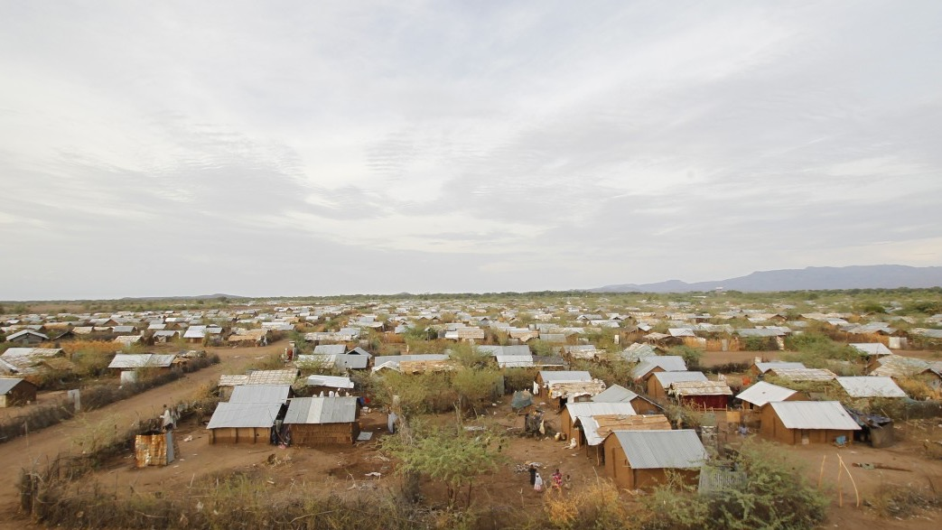
RILx23
Smart Communities Coalition: 5 Years of Connecting Businesses and Nonprofits in East Africa
June 2023

Slide 2
Agenda
Background
Activities
Partnerships
Results
Next Steps

Slide 3
Smart Communities Coalition (SCC) Background
The number of refugees and internally displaced people across the globe continues to grow, while funding for humanitarian assistance declines, with a funding gap of $4.3 billion in 2018
Gaps in collaboration, technology innovation and streamlining efforts in displacement settings exist
No one organization is responsible for energy, connectivity, and digital tools despite their foundational role in livelihoods and economic growth opportunities, refugee settlement management, and efficient service delivery to refugees and host communities
In 2018, USAID and Mastercard identified a need for such a coalition and launched the Smart Communities Coalition (SCC), a unique collaboration that connects public and private stakeholders across their core strengths to address three fundamental pillars: Energy, Connectivity, and Digital Tools
SCC shares learnings, conducts matchmaking between partners, funds projects and leverages private sector expertise to demonstrate proof of concept and scale-up potential for innovative service delivery
Energy
Connectivity
Digital tools
Notes:
Launched mid 2018, when USAID and Mastercard identified there was a gap in how services to displaced services were delivered, specifically with three pillars (energy access, connectivity, and digital tools). The Coalition is meant to bridge people of different sectors and get innovative approaches to service delivery.
In Uganda, 94% of refugees live in settlements and 81% of these refugees are women and children. As the number of forcibly displaced individuals continues to grow and accelerate, their needs are outpacing the donors’ ability to meet them. The SCC, a unique & collaborative platform, aims to bring together and incentivize the private sector to serve this market in a sustainable manner focusing on energy, connectivity, and digital tools.
The SCC provides hands-on matchmaking for private sector players to help them work together, as well as funding if/where necessary to spur innovation and/or scale. Without this support, the private sector will continue to under-serve the refugee market, as related to digital tools, connectivity and energy, which they see as risky and non-commercially viable. More specifically, the SCC allows public and private sector organizations to share best practices, facilitates partnerships between our members through “offer and ask” sessions, and engages with donors to find funding for SCC member-led projects.
All three pillars are interconnected as connectivity is challenging without energy, PAYGO needs connectivity and financial services, and digital financial services need connectivity and energy to charge phones.

Slide 4
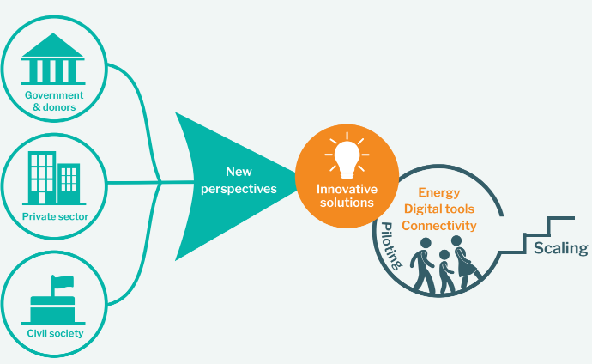
SCC Methodology
SCC activities are focused on:
Increasing coordination among Coalition members to improve service delivery displaced communities through technology and partnership solutions
Implementing activities (tools, investment, projects, etc.) that empower refugees through improved economic growth opportunities
Enabling UN agencies and NGOs that manage the refugee response with increased efficiencies thus stretching their funding for greater impact

Slide 5
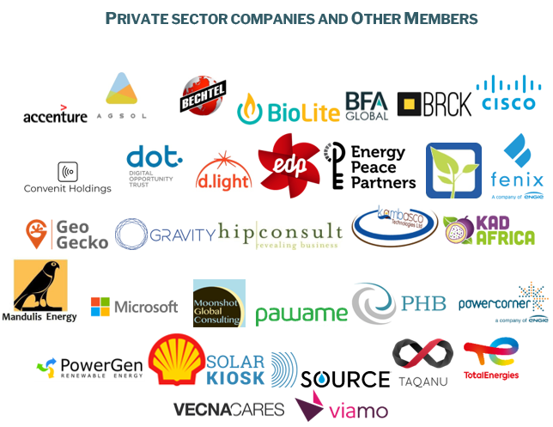
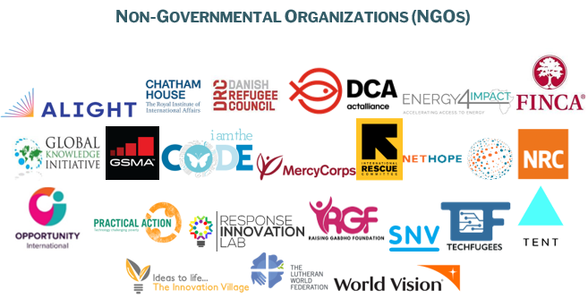
SCC Members and Collaborators
Notes:
Additional members have been added since this slide (e.g. AECF)
Non-governmental organizations, international donors, and businesses often advance their humanitarian, development, or commercial objectives along separate tracks in their pillar area of energy connectivity and digital tools. These siloed efforts stifle collaboration and limit the benefit and collective impact of joint activities. As the SCC, we enable organizations to collaborate, that is when they can make a greater impact and improve outcomes for those we serve. One example -- after connecting during the New Member Welcome Call, Farm from a Box engaged with the team at bechtel.org to streamline their product design and trend for quantity and scale. Bechtel.org has examined FFAB’s core design to ensure optimal performance and efficiency. They are also helping Farm from a Box determine the most affordable, easy-to-deploy, ruggedized solar racking system to secure the 21 kW array that powers their new 10-acre farm system.

Slide 6
Agenda
Background
Activities
Partnerships
Results
Next Steps

Slide 7
SCC Projects
Pilot | Status | Partners | Impact | Funding | Description
De-risking Pay-As-You-Go (PAYGO) Solar Home Systems (SHS) in Uganda | Completed (2018-2020) | USAID/Power Africa, Green Powered Technology and Energy4Impact | 4,137 solar home system sold; Employed 285 refugees and host community members | $704,121 from USAID/Power Africa | -Motivated by SCC, grants given to three SHS companies to begin sales in Kiryandongo and Rwamwanja settlements in Uganda: BrightLife, Fenix and SolarNow -All 3 grantees are continuing sales in settlements (two companies: PAYGO, one: cash-based until PAYGO repayments are collected) -Lessons learned shared with SCC community via webinar and pilot playbook
U.S. African Development Foundation (USADF) SCC Grant Window | Ongoing (2019-present) | USAID/Power Africa, USADF, EDP Renewables | 1,155 connectivity, 775 digital tools and 11,521 energy beneficiaries; 1,995 jobs created | $750,000 from USADF/Power Africa | -Motivated by SCC, grants provided by USADF to empower 7 local businesses to address energy challenges and sustain operations in 5 refugee settlements and host communities in Kenya and Uganda -Projects range from mini-grids for ICT services and electricity to SHS for lighting, charging phones and providing electricity for stores
Notes:
Yellow means that projects are reaching customers

Slide 8
SCC Projects (continued)
Pilot | Status | Partners | Impact | Funding | Description
Rwamwanja mini-grids | Planned | USAID/ Power Africa | TBD | $1M+ from Power Africa | -Grants and technical support for mini-grid project in Uganda -Finalizing implementation mechanism
SCC Innovation Fund (SCCIF) | In process (2021-2023) Grants not yet fully disbursed | USAID/ Power Africa, EnDev | TBD Expected: 3,500 households | $1,00,000 from USAID/ Power Africa | -Six consortia including local private companies selected to implement innovative projects in settlements and host communities in Kenya and Uganda
Notes:
Yellow means that projects are reaching customers

Slide 9
SCC Projects (continued)
Pilot | Status | Partners | Impact | Funding | Description
Digital Agents for Energy+ | Completed (2018-2021) | Mastercard, Norwegian Refugee Council, International Trade Centre and TotalEnergies | -47 solar energy products sold -21 agents trained and hired -10 agents conducted sales for wholesalers | $196,000 from FCDO and +$200,000 mobilized by SCC members | -Convened at SCC event, SCC members created training program for refugees and host community members in Kakuma and Kalobeyei in Kenya; focused on selling small solar energy products provided by TotalEnergies -Mastercard served as project manager and assisted in securing grant funding - Agents and wholesalers were remotely trained on Mastercard’s Digital Agents platform, TotalEnergies products, and entrepreneurship topics
Notes:
$80 per person

Slide 10
Learning Products Created by the SCC
Product | Description
Digital financial services assessment | Assessment created by financial inclusion working group that summarizes barriers, drivers and opportunities for financial inclusion of refugees in Kenya and Uganda, based on field data
Offers and Asks spreadsheet | Live “Offers and Asks” document where members listed offers and requests for support, project ideas and expertise
Pilot playbook | Standardized pilot summary to share lessons learned and recommendations for practitioners completed for De-risking PAYGO SHS pilot
Market profiles | Market data on three pillars in settlements in 7 settlements in Kenya and Uganda
Member Heatmap | Digital overview of member assets and operating geographies, used to identify member capabilities and partnership opportunities
Webinars | SCC-hosted webinars for the community to share learnings and reduce duplication of efforts, including Uganda De-Risking PAYGO pilot, Shell Enter Energy initiative’s report, and Access to Modern Energy in Humanitarian Settings (AMPERE) pilot)

Slide 11
Agenda
Background
Activities
Partnerships
Results
Next Steps

Slide 12
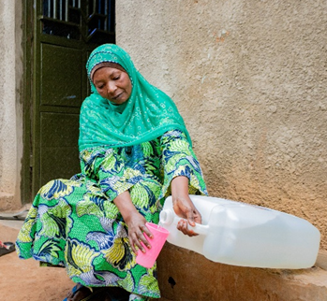
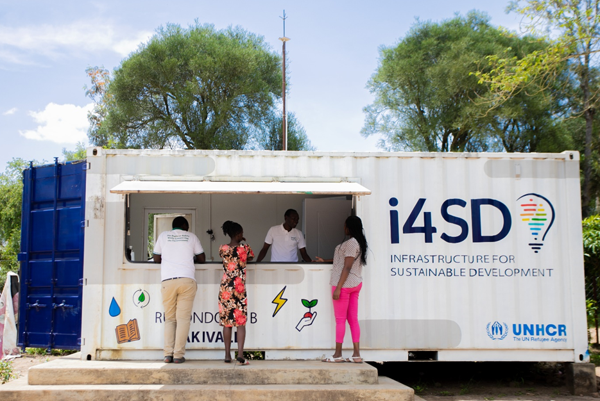
SCC Innovation Fund (SCCIF)
Recognizing existing gap for cross-sector funding in displacement settings, created dedicated fund for private sector mobilization and advancing ideas to implementation with $1,000,000 provided by USAID/Power Africa managed by EnDev/GIZ
Round I
Four consortia selected in January 2021 as first cohort in Uganda and Kenya. Expected impact: 3,500 displaced and host community households in Kenya and Uganda
In Kenya:
Solar E-Cycles, Strathmore University and OFGEN: e-mobility solution in Kakuma.
Uganda:
Moban SACCO, BiziSol and OffGridBox: solar-powered solution for energy, water and connectivity in Nakivale.
PHB Development, Yelekeni Farmers’ SACCO, BrightLife and UltraTech: solar-powered hatchery and SHS for small-scale poultry farming in Kiryandongo.
Round II
Three winning consortia in Uganda announced in April/May 2023
Notes:
E-Bikes in Kakuma-Kalobeyei (Kenya): 119 308€ grant + 10 000€ own funding for Solar E-Cycles Kenya Ltd (lead), Strathmore University and OFGEN
Solar-powered chicken value chain in Kiryandongo: 85 360 € grant + 31 000€ own funding​ for PHB Development (lead), Yelekeni Farmers' SACCO and BrightLife
Connectivity, energy and water utility in Nakivale: 90 649€ grant + 9 100€ own funding​ for Moban SACCO (lead), BiziSol and OffGridBox

Slide 13
Additional SCC-Catalyzed Partnership Examples
Cross-sector partnerships among SCC members
Advocacy on mobile access
- FSD Africa and GSMA came into contact via SCC
- Cooperated on advocacy effort resulting in Ugandan government adopting a more proportionate and enabling policy on refugees’ proof of identity for mobile access
Engineering design review
- Bechtel.org and FFAB met during SCC new member webinar
- Bechtel.org helping FFAB streamline product design for quantity and scale, and providing engineering design review
Assessing customer credit worthiness via savings groups
- Ugandan company Kambasco & Equity Bank developing automated credit assessment tool to enable last mile distributors predict creditworthiness

Slide 14
Agenda
Background
Activities
Partnerships
Results
Next Steps

Slide 15
SCC Results
Inputs
Outputs
Sharing best practices from projects in displacement settings
Matchmaking to identify opportunities for new projects
Convene public, private and NGO members via digital and in-person events
70+ members
5 pilot projects
Results from SCC pilots ~50K indiv. impacted (data as of 2021):
1,155 beneficiaries with new or improved access to connectivity
11,547 households with new or improved access to energy
775 beneficiaries with new or improved access to digital tools
73,612 USD in beneficiary income savings due to access to new products and services
2,279 jobs created
4,729 clean energy products sold;
7,124 kWh (kilowatt-hours) of clean energy
Notes:
-2 completed: Uganda De-risking SHS PAYGO grant (Uganda), Digital Agents for Energy+ (Kenya)
-3 ongoing: USADF grantees (Uganda), financial inclusion working group (Uganda and Kenya) and SEPARLE project (Uganda)
-Results are as of 2021 from (i) Uganda De-risking SHS PAYGO grant pilot, (ii) USADF grantees, (iii) Digital Agents for Energy+ in Uganda and Kenya.
- 10 partnerships:
SCC-facilitated partnerships:
o Farm from a Box and Bechtel - engineering design review for FFAB’s off-grid energy and farming product.
o Equity Bank and Kambasco - assessing customer credit worthiness via savings groups
o MAKE Change - Integrated mini-grid development in Kenya
· Other pilots/partnerships from SCC members:
o WorldVision and Convenit Holdings - TV white space
o WorldVision and Practical Action - clean cooking biomass study
o Mercy Corps and Fenix - PAYGO sales agent training pilot
o Mercy Corps and d.light - Accessing Markets through Private Enterprises for Refugees’ Energy Access (AMPERE)
o GSMA and FSDA - Advocacy on mobile access
o Software Enabled Powering Agriculture Livelihoods Enhancement (SEPARLE) - funded by Humanitarian Grand Challenge
o Shell and Mercy Corps - Enter Energy in Ethiopia

Slide 16
Testimonials
Beneficiaries
The project will assist the community by ensuring there is enough lighting at homes especially for students who do their homework at night. As a businessman, I expect to make profit through sale of the solar products through Digital Agents for Energy+ that will expand my business.
Abdi Hussein Noor, Somali refugee and Digital Agent in Kakuma 4
As a Digital Agent I want to be trained on business skills and also earn money that I can use to start my own business in future. I look forward to interact with the community and make a difference to other ladies in the camp.
Rita Brown, Ugandan refugee and Digital Agent in Kakuma 1
SCC Members
The SCC provides a valuable platform to partner, learn and validate assumptions – it’s only through learning from each other that we can ensure our actions address the most critical needs of vulnerable groups in a sustainable and viable way.
Shell
RGF joined the SCC because we wanted to access contacts and shared wealth of resources and expertise. On our own we are limited with how much we can do, but in a community, we have access to a pool of knowledge, resources and support.
Raising Gabdho Foundation

Slide 17
Agenda
Background
Activities
Partnerships
Results
Next Steps

Slide 18
Secretariat 2.0: SCC and RIL Integration
As of May 2023, the SCC and RIL have announced a formal merger, with the SCC becoming RIL’s private sector convening arm
Knowledge management:
Transition SCC knowledge products from Mastercard website to U-Learn platform
Brokering partnerships:
All SCC members added to RIL convening events, including possible in-person series of events in Kampala and/or Nairobi
SCC members added to RIL ecosystem mapping
RIL staff available to help members find information, partners & solutions to their challenges
Next steps:
Kick off event in Kampala (held June 2)
Kick off event in Nairobi (current)
Future events & announcements to follow

Slide 19
We look forward to engaging with you!
The SCC & RIL

