Slide 1
Local Procurement Learning Partnership (LPLP)
Introducing the
Local Procurement Learning Framework

Slide 2
Introduction to the LPLP
Multi-stakeholder partnership (join us!)
Hosted by the Humanitarian Logistics Association (HLA)
HNPW sessions – more and more on local procurement!
Capacity building
Technical assistance
Information sharing & market visibility
Policy advocacy & change
Efficiency
Resilience
Local Markets
Who?
What?
Why?
Notes:
The Local Procurement Learning Partnership (LPLP) is a multi-stakeholder partnership hosted by the Humanitarian Logistics Association. We provide capacity building, technical assistance, information sharing and policy advice to increase the local procurement of humanitarian aid supplies. Partners currently include humanitarian agencies, suppliers and manufacturers, and we aim to make aid more efficient, to build resilience and to support local markets.
The LPLP is built on the premise that the future of aid is local, and that procurement offers us the opportunity to engage directly with crisis affected populations. This learning partnership will ask us to rethink the way we procure, but also the ways we programme activities and the ways we ascribe value.
2

Slide 3
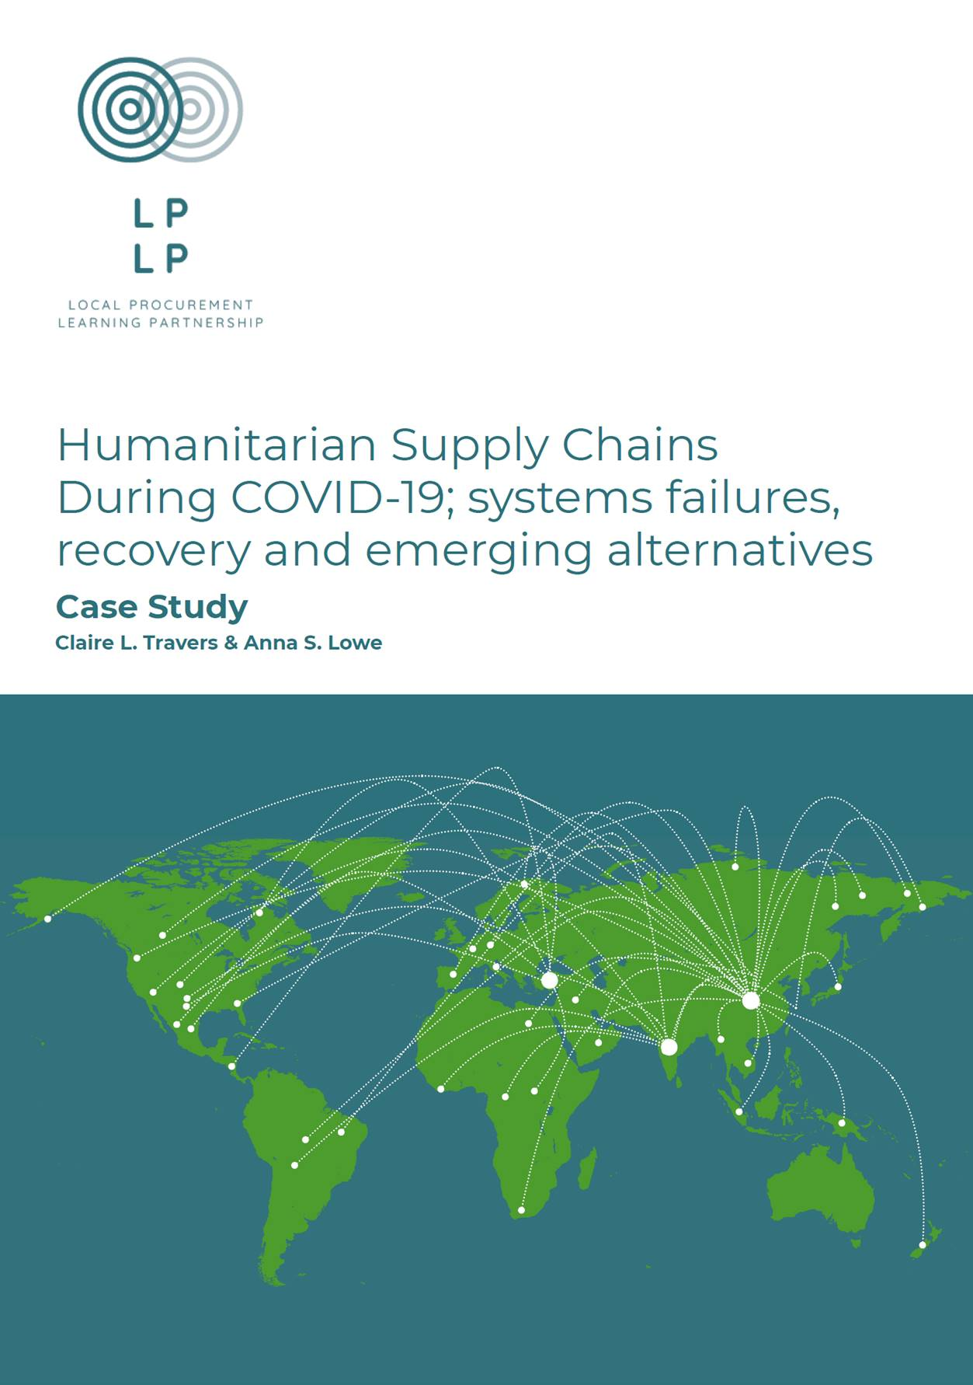
Previous activities of the LPLP
Research & evidence
Humanitarian supply chains during Covid-19 – full report
Localisation in humanitarian logistics – KCL research
Supplier databases – MIT research
Convening & learning
Local Procurement track at Health & Humanitarian Logistics Conference
Fundraising & partnerships
BHA ecosystem funding bid
South Pacific localization activities – WASH kits
Steering Committee meetings
Notes:
3

Slide 4
Current activities of the LPLP
Local Procurement Learning Framework
H2H Accelerator to kick start system building activities
Kenya case study of the framework, focused on health supplies
Starting work on local manufacturer’s experience
“Towards Mass Customization of WASH Kits”
UNICEF-led project supported by Innovation Norway
Overcoming the procurement barriers introduced in the sector by standard kits
Implementing in Kenya & State of Palestine
Notes:
4

Slide 5
Local Procurement
Learning Framework

Slide 6
Urgent Need for Action
Climate crisis! Reduce shipping, reduce carbon
Greater need & fewer resources
Pandemic – international supply chains failed… self reliance critical
Aid money can go further through local markets
Donors own regulations limiting funds for local markets
Some donor requirements create unfair competition for the smaller local suppliers.
Local vendors struggle with process and compliance barriers
Aid targets local resellers rather than local manufacturers
Limited financing for local manufacturers
… time to build a better system
Notes:
1. We are shipping soap and other relief items around the planet whenever there is a crisis! Growing anger about imports
2. Aid sector must do more with less. The humanitarian aid system now cannot cope with the scale of demand. World’s technology base has changed – the aid sector is out of date.
3. During the pandemic supply chains fail. Everyone needs to become more self reliant.
4. New normal is that global shipping is more expensive and more fragile. Meaning that the most vulnerable people are being left behind. They are the last to receive assistance. Cheaper better and faster to make locally, so Aid funds can go further.
- Local manufacturers have a hard time engaging with aid sector. We have an enormous opportunity.
- Increase resilience, reduce dependency. Factories closed because aid orgs gave free stuff.
- Food sector has learned to work with local farmers. We have to do the same with finished products

Slide 7
Vision for successful Local Procurement
Sourcing as locally as possible
and as globally as necessary
to increase local economic development,
market independence and quality,
response capability and resilience to shocks
Notes:
To localize procurement of aid items and capitalize on improved local manufacturing capabilities, two fundamental challenges must be addressed:
Demand side: How can buyers (donors, governments, international and implementing organizations) be helped to adopt policies and practices to procure locally made supplies?
Supply side: How can local suppliers and manufacturers prepare to sell to the aid market?
A new system that supports local procurement practices, better suited to local contexts.
A neutral [local] entity (comparable to initiatives such as CaLP and Sphere ???) with broad and active membership of donors, agencies and companies to ensure ongoing relevance and support sustainability.
To increase local economic development, market quality, response capability and resilience to shocks, aid and public sector buyers buy products that are assessed through the framework [??]

Slide 8
Framework Scope
Local Procurement
Local Manufacturing
Local Supplier visibility
Humanitarian
Nexus
Development

Slide 10
Why LPLP
We Enable System Building - Network & local access to orchestrate the building and enhancement of a new system
We engage collaborators - Experience leveraging partners to work on the system rather than in the system
We are building a platform with broad reach
We have a Local Procurement Framework
Notes:
We Enable System Building - we have (or will have) a Choreographer to lead system building efforts
We Engage Collaborators – we bring a diverse range of collaborators to the table, meaning more powerful and successful systems.
We have a Complete Framework - we don’t propose piecemeal projects that won’t deliver working systems. We provide a practical view of a working future system.
Expertise – we have seasoned experts from aid, private and academic sectors with hands on experience, which formed the LPLP
LPLP’s role is primarily advocacy / thought leadership – but tools are needed
There is no intent to compete with existing initiatives.
Initiatives will seek to fill gaps in learning.
Focused activities will be conducted through partners around procurement, manufacturing, co-ops etc.

Slide 11
Sustainability Model
Small, nimble and global governing body
National branches to lead local change
Complimentary strategic partnerships
Sustainable income from
HLA membership fees (several value added services)
Fees from Global Supplier Register
Consultancy and training services on Local Procurement
System Building and Enhancement Project income
Sponsorship and event (with global media partner)

Slide 12
THANK YOU!

